Slide 1
Robot Design Overview
Team: @Rising Stars
Team No : 66782
Ria
Lego League 2025
Theme: Unearthed
f
Notes:
Ria

Slide 2
Team Members
Ria
Name Age
Riona Panda 10
Zoey Jain 11
Shaivi Aggarwal 11
Saanvi Loomba 11
Saumya Loomba 11
Girisha Gupta 11
Riya Patil 12
Notes:
Ria

Slide 3
Mission Strategy
Saanvi
Took mission board print out and marked on those sheets to find missions and path required.
Tried individual missions first and then combined them to optimize runs and time.
Tried various combinations to maximize score.
Picked ones that can be completed in 2.5 minutes and gives maximum score
Notes:
Saanvi

Slide 4
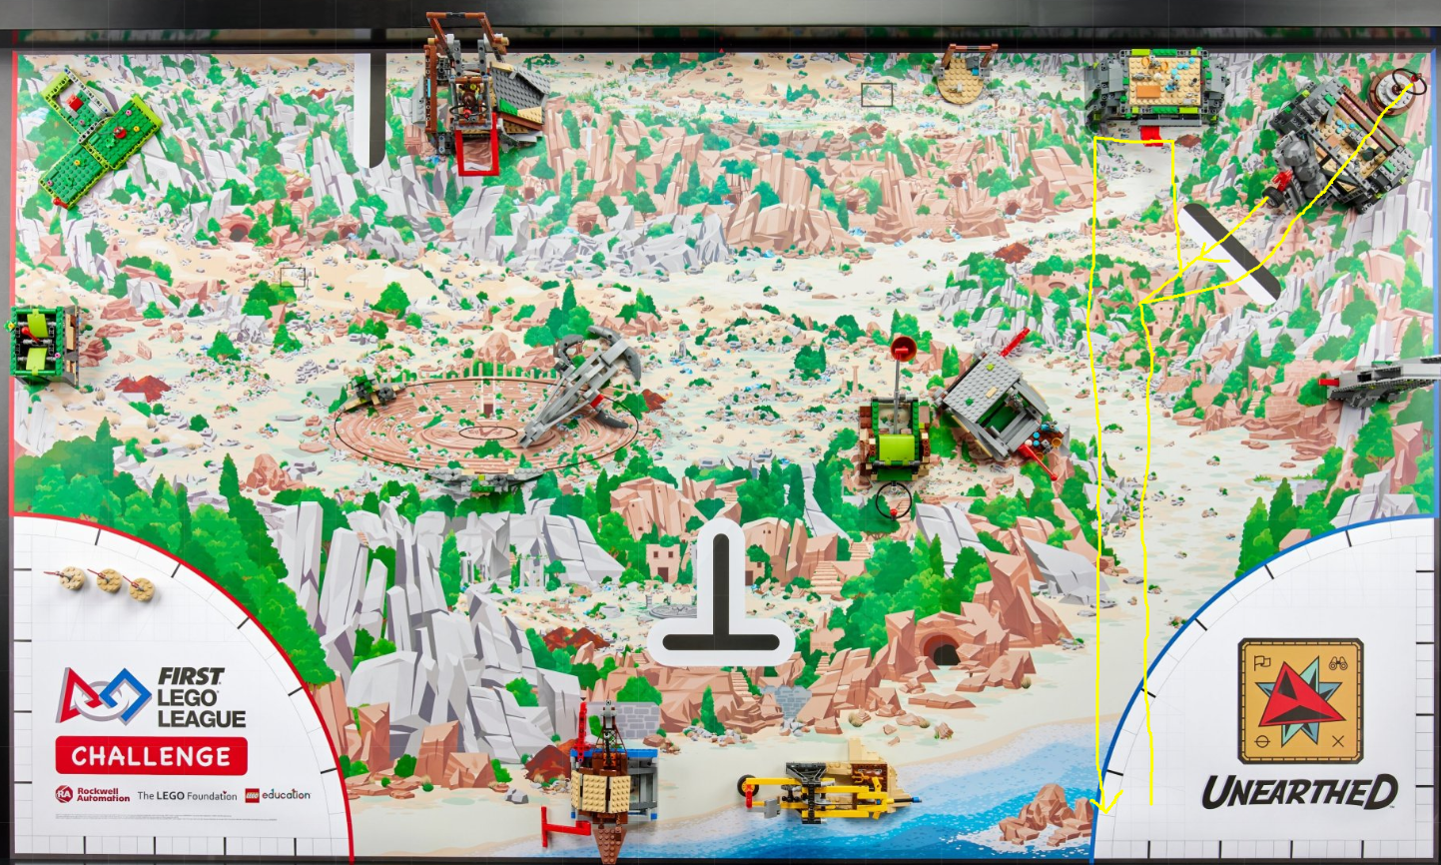
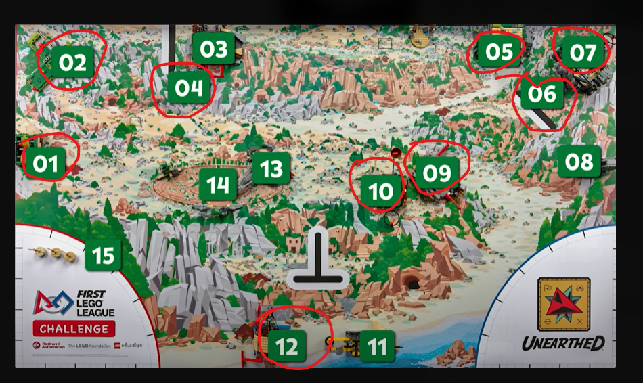
Mission Strategy
Saanvi
Notes:
Saanvi

Slide 5
Resources Used
Zoey
Spike Prime Lessons
Online FLL Tutorials
Solon STEM scrimmage
Talked to other team coaches
Lego Studio 2.0
Notes:
Zoey

Slide 6
Skill building
Shaivi
Did basic programs to move straight, turn, use sensors and motors
Created Pseudo code with paper and pencils
Shared and improved
Used gyro and color sensors to make our mission runs more reliably
Distributed work in two groups to get things done faster
Created reusable code blocks for different missions
Attended Solon STEM scrimmage and used learnings for improvement
Notes:
Shaivi

Slide 7
How we worked as a team
Shaivi
All 7 girls tried building and coding
We took turns and alternated between innovation project and robot building/coding
We rotated drivers, builders, and coders
Each person helped design at least one attachment or routine
Notes:
Shaivi

Slide 8
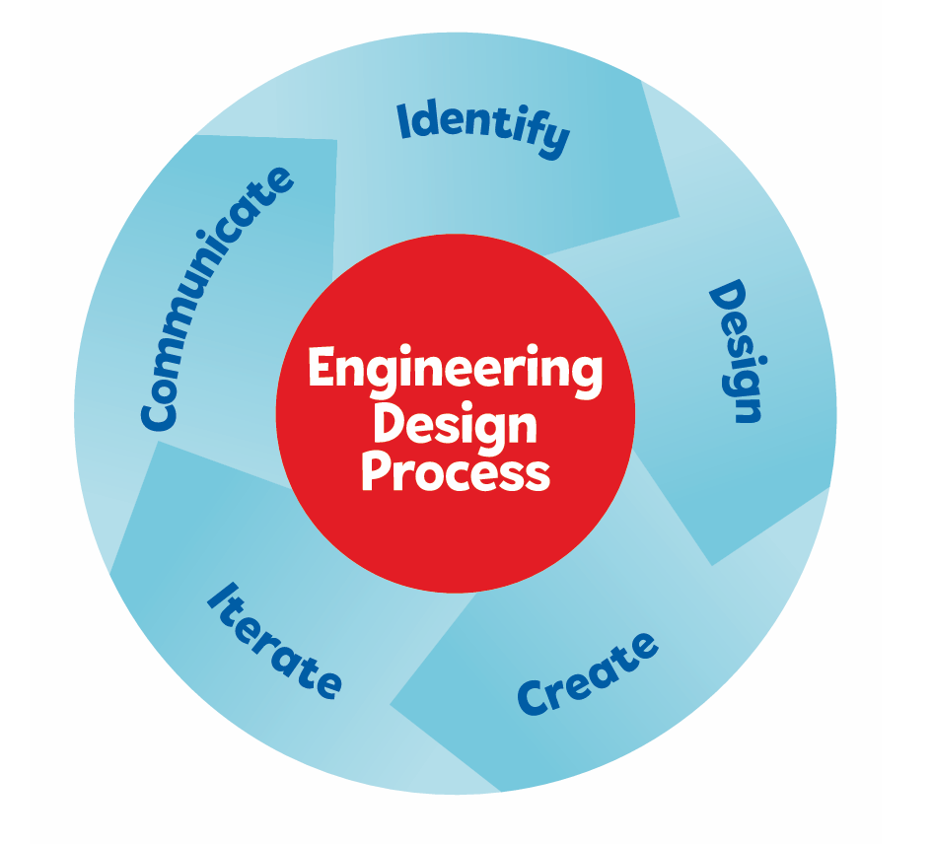
DESIGN- Robot Design
Saumya
Reviewed mission board and various missions
Tried 3 different designs before picking final version.
Used Engineering Design Process to iterate and improve.
Combined learnings from last season and 3 earlier designs to design selected design.
Tried many runs to make small incremental improvements.
Notes:
Saumya

Slide 9
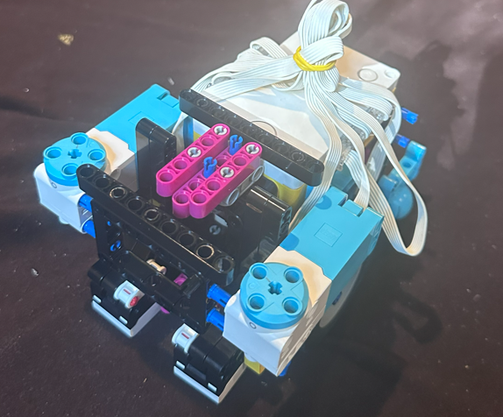
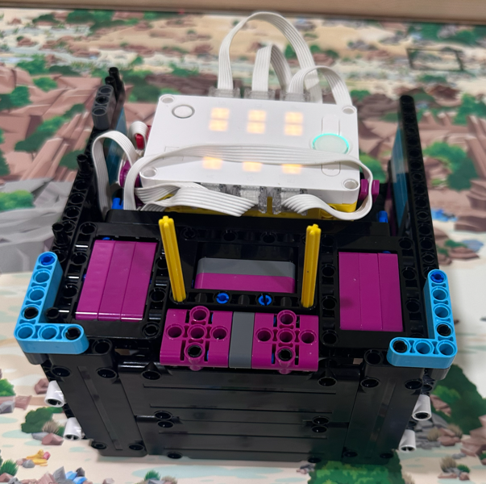

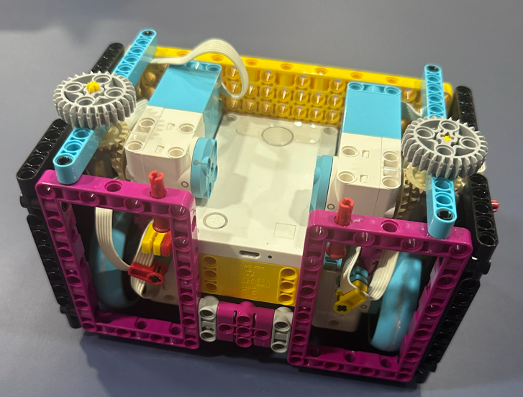
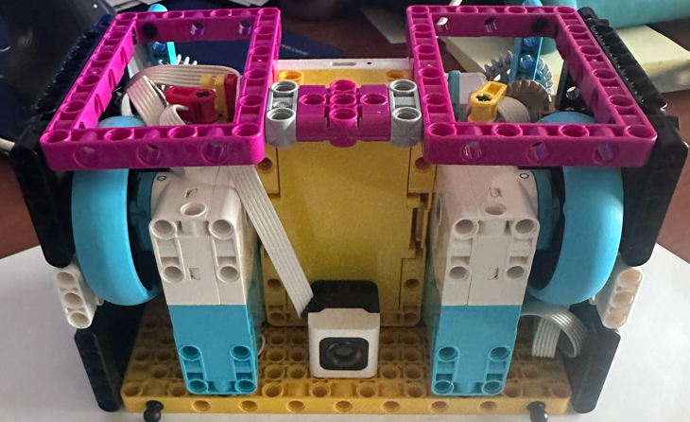
DESIGN - Iterate and learn
Saumya
Third
Current
Second
First
Notes:
Saumya

Slide 10
DESIGN- Key Components and Considerations
Girisha
Box design : Flat frames on all sides: lets us swap attachments quickly between runs
4 Motors
2 for Wheels
2 for attachments
More powerful motors for attachments and rubber wheels
1 caster wheels with steel ball
Charge port accessible
2 Color sensors
Notes:
Grisha

Slide 11
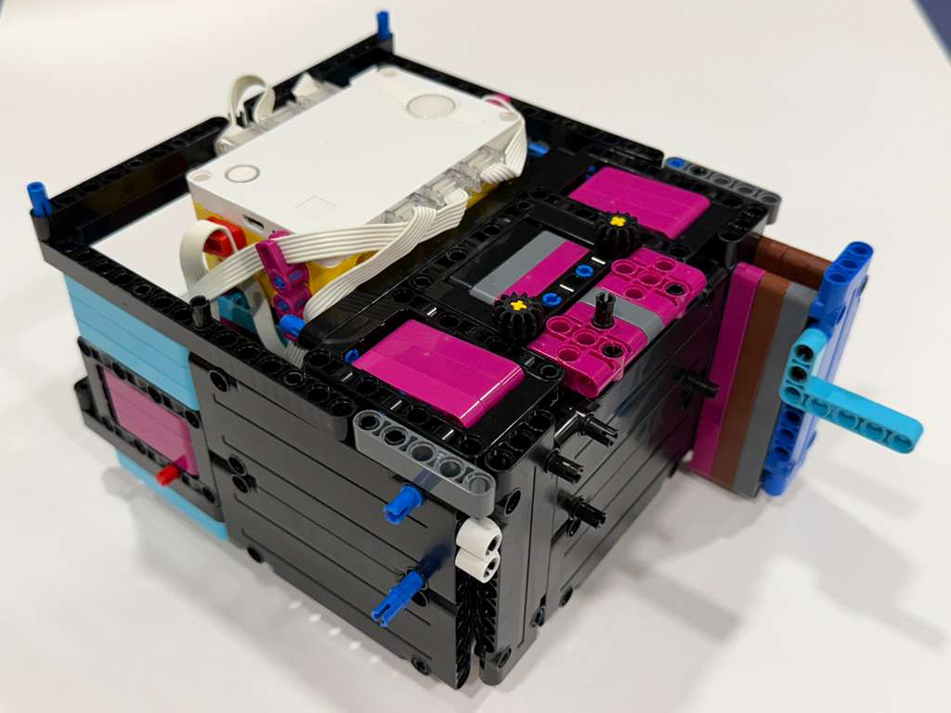
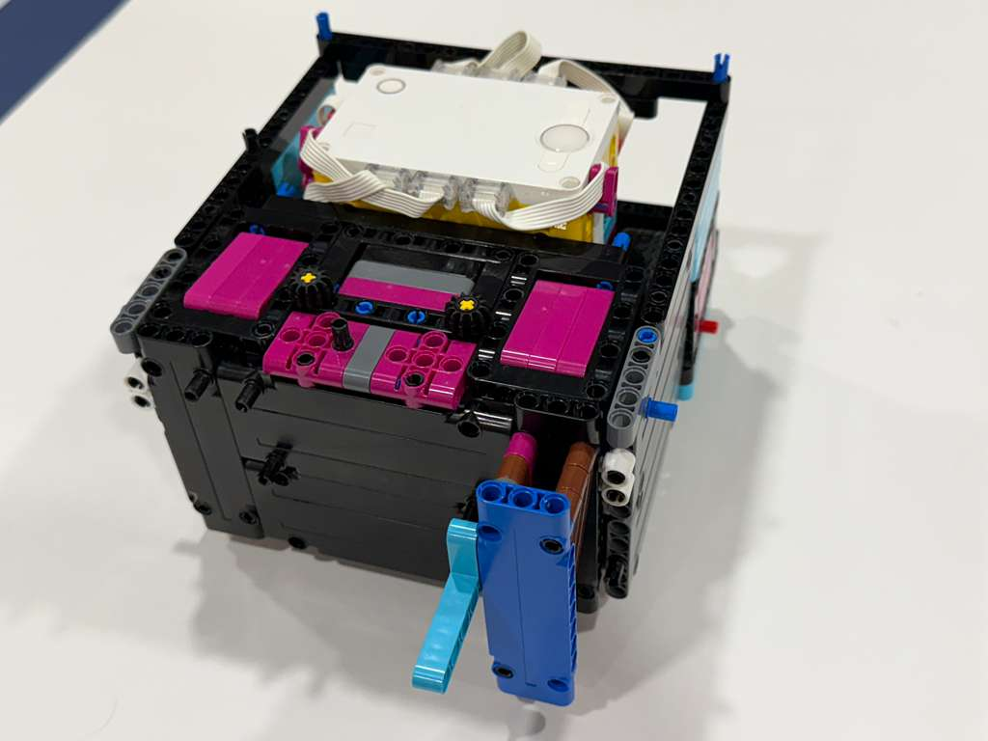
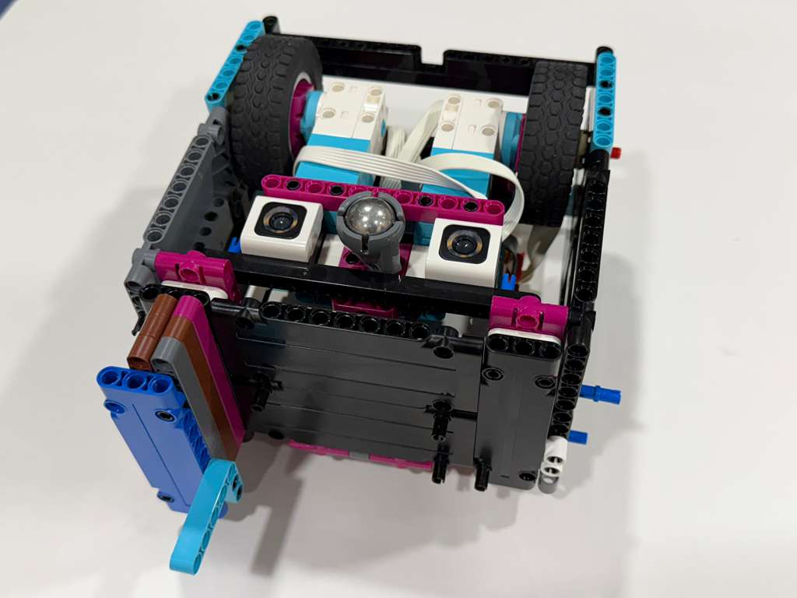
Selected Design of Robot
Girisha
Notes:
Girisha

Slide 12
What We Learned from Robot Design
Zoey
Testing and changing small things can make a big difference
Using sensors makes the robot more reliable than only timers
Robot weight need to be evenly distributed
Reset motors after every run for accuracy
Notes:
Zoey

Slide 13
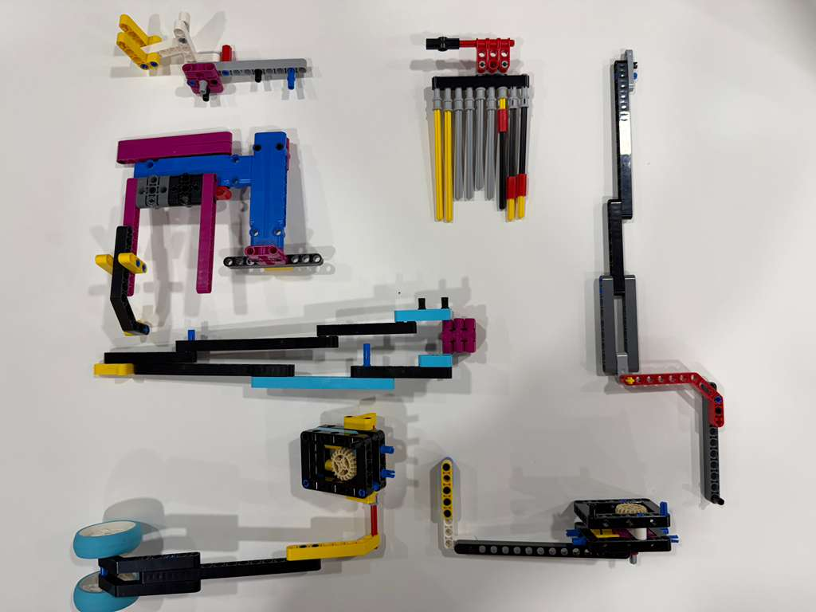
CREATE - Attachments Developed
Ria
It’s easy to add attachments on left and right side of front of robot.
We also made several simple attachments for missions
Notes:
Riya

Slide 14
CREATE - Sample Reusable Routines(Myblocks) developed
Riona
Move Straight Accurately
Move Left
Move Right
Move Reverse
Move Right Arm
Move Left Arm
Notes:
Riona

Slide 15
Share and Enjoy
Riona
We took turns and shared workload and experience.
Team had 7 girls and we became good friends and worked and had fun together.
At times robot did not work as programmed and broke models and seeing it fail was funny.
We had so much fun during field trip at Nelson Leges Quarry park.
Notes:
Riona

Slide 16
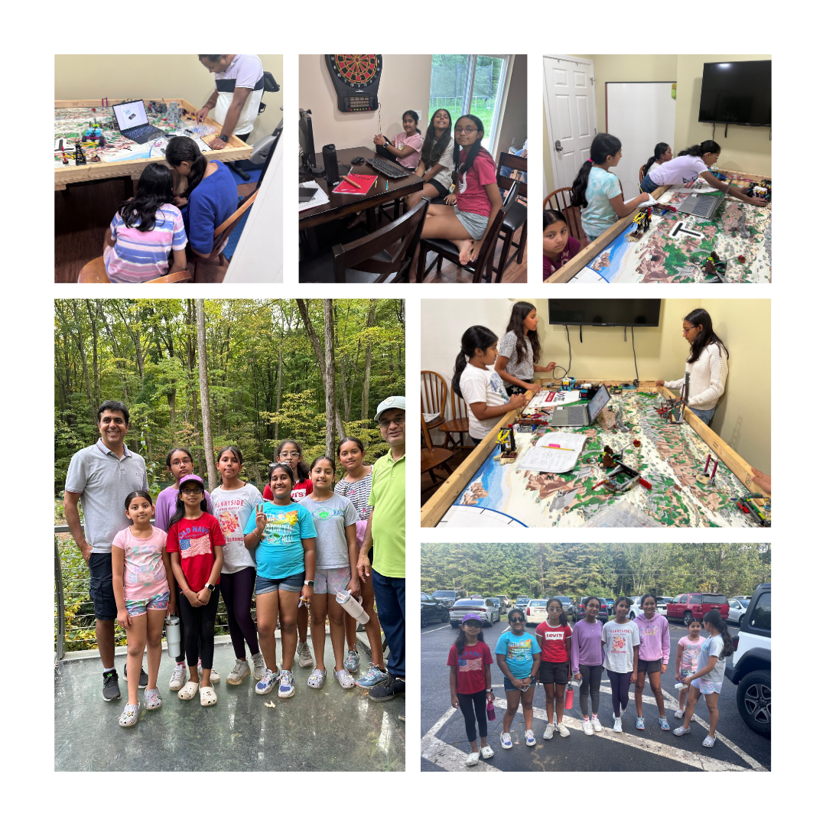
Riona
Notes:
RIona
Here are some pictures we captured during our season with some fun moments

